Slide 1
Телеграм бот “Модератор”
Фельдман ЛЕВ

Slide 2
Problem Situation
Before creating your slides, you should have a clear understanding of what you want to accomplish with your presentation. Are you trying to persuade the committee members to approve your technical assignment? Are you trying to provide an overview of your project? Or are you trying to explain technical details to a non-technical audience? Knowing your purpose will help you determine the tone and structure of your presentation.

Slide 3
Proposed solution:
To achieve this, we will develop a Telegram bot using the aiogram framework that can perform the following actions:
Ban users: The bot will have the ability to ban users for a specified period or permanently. This will be done by using the Telegram API to send the ban command to the channel.
Delete messages: The bot will also have the ability to delete messages with obscene language or inappropriate content. This will be done by using the Telegram API to send the delete command to the channel.
Moderation commands: The bot will be equipped with moderation commands that allow moderators to manage the channel effectively. These commands may include view user information, remove a user from the ban list, and view deleted messages.

Slide 4
Technical Details
To develop the bot, we will use the following resources:
aiogram framework: This is a powerful Python framework that provides tools for developing Telegram bots.
Telegram API: This is a set of interfaces that allow developers to interact with Telegram services.
Hosting service: We will need a hosting service to deploy the bot. This could be a cloud hosting service like AWS, Google Cloud, or Digital Ocean.

Slide 5
Resources and Risks
Security risks: The bot may be vulnerable to attacks such as hacking, phishing, or malware. To mitigate this risk, we will ensure that the bot is developed with strong security measures in place.
Privacy risks: The bot may collect sensitive user data, such as personal information or chat history. To mitigate this risk, we will ensure that the bot adheres to Telegram's privacy policy and only collects the necessary data.
Technical risks: There may be technical issues that arise during the development process, such as compatibility issues or bugs. To mitigate this risk, we will conduct thorough testing and debugging before deploying the bot.

Slide 6
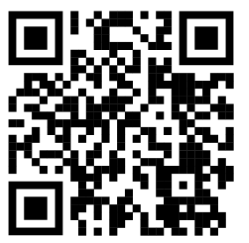
Показ на практике
@makeworkbot

Slide 7
Спасибо за внимание

